Slide 1
Friendship

Slide 2
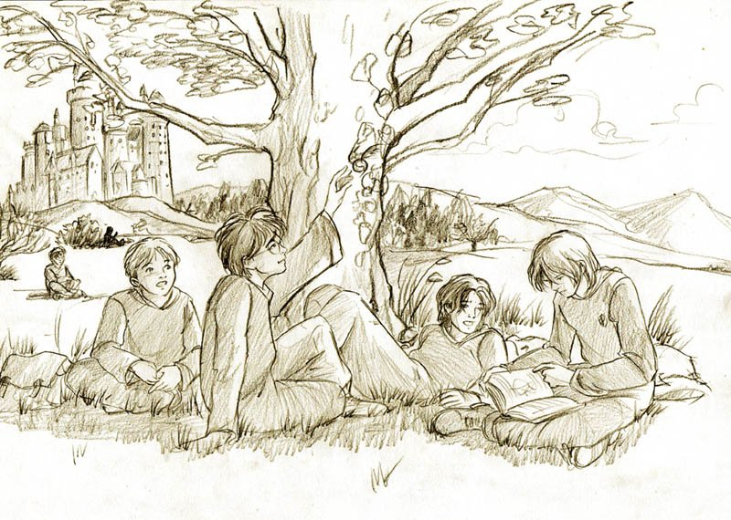
What Friendship Means
Friendship is a sheltering tree. Samuel Coleridge:

Slide 3
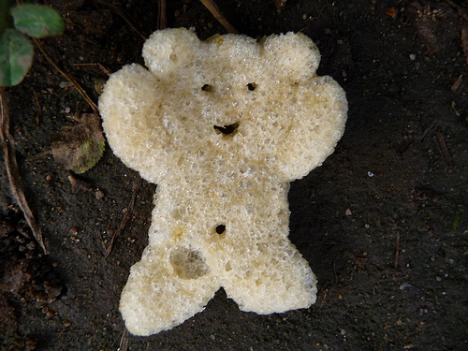
What Friendship Means
It is not so much our friends' help that helps us as the certain knowledge that they will help us. Epicurus

Slide 4
What Friendship Means
It is one of the blessings of old friends that you can afford to be stupid with them. – Ralph Waldo Emerson

Slide 5
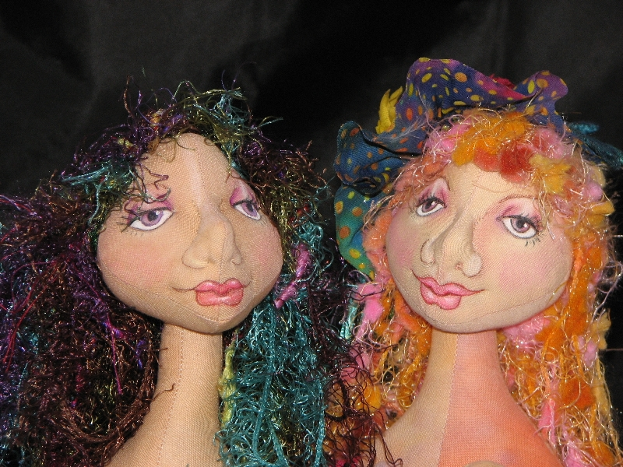
What Friendship Means
Friendship is born at that moment when one person says to another: "What! You, too? I thought I was the only one.“ -- C.S. Lewis:

Slide 6
What Friendship Means
A real friend is one who walks in when the rest of the world walks out.-- Walter Winchell

Slide 7
What Friendship Means
My friend is someone who will tell me my faults in private. -- Solomon Ibn Gabirol

Slide 8
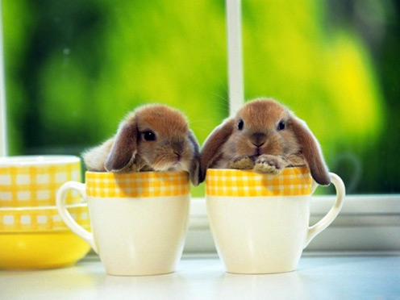
What Friendship Means
A true friend is someone who is there for you when he'd rather be anywhere else. -- Len Wein

Slide 9
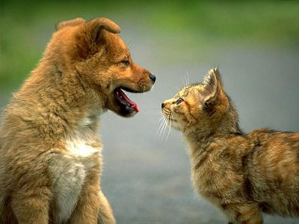
What Friendship Means
A friend is one who knows us, but loves us anyway. -- Fr. Jerome Cummings

Slide 10
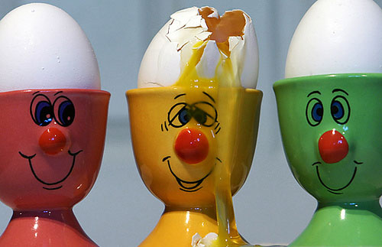
What Friendship Means
A true friend is someone who thinks that you are a good egg even though he knows that you are slightly cracked. -- Bernard Meltzer.

Slide 11
What Friendship Means
When it hurts to look back, and you're scared to look ahead, you can look beside you and your best friend will be there

Slide 12
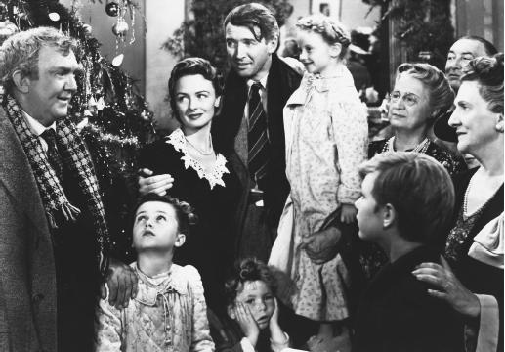
What Friendship Means
Remember, no man is a failure who has friends. – “It's a Wonderful Life”

Slide 13
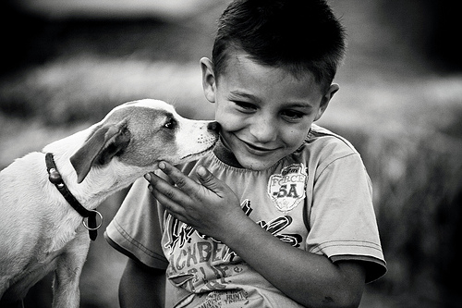
How to Make Friends (and Keep Them)
The only way to have a friend is to be one. -- Ralph Waldo Emerson

Slide 14
How to Make Friends (and Keep Them)
One who looks for a friend without faults will have none. -- Hasidic Saying

Slide 15
How to Make Friends (and Keep Them)
You can make more friends in two months by becoming really interested in other people, than you can in two years by trying to get other people interested in you. -- Bernard Meltzer

Slide 16
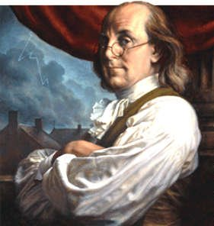
How to Make Friends (and Keep Them)
Harsh words make no friends; a spoonful of honey will catch more flies than a gallon of vinegar. ---Benjamin Franklin

Slide 17
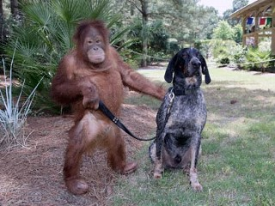
How to Make Friends (and Keep Them)
Don't walk in front of me, I may not follow. Don't walk behind me, I may not lead. Just walk beside me and be my friend.-- Albert Camus

Slide 18
Ecclesiasticus 6:14: A faithful friend is a strong defence: and he that has found one has found a treasure.

